Slide 1
One Dimensional Quantum Mechanics: The Free Particle
Luke Corcos with Jacky Chong
Directed Reading Program

Slide 2
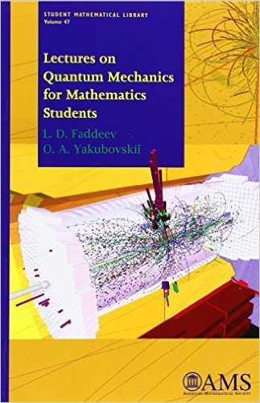
Books
Lectures on Quantum
Mechanics for
Mathematics Students
by Faddev and Yakubovskii
Modern Quantum Mechanics
by Sakurai

Slide 3
Introduction
Quantum mechanical behavior is described by the Schrödinger equation:
Time Dependent:
Time Independent: E=Energy; h=Plancks constant

Slide 4
Introduction
Hamiltonian:
Q= Position Operator
P= Momentum Operator
 | Coordinate Representation | Momentum Representation
Q
P

Slide 5
Free Particle (V=0)
When V=0:
Let’s first look at solution of the Time-Independent Schrödinger Equation and solve for the spectrum of the Hamiltonian Operator

Slide 6
Spectrum of Free Particle
In the coordinate representation:
So
For simplicity, define units such that h=1 and m=1/2 Define the wave number k>0 s.t.

Slide 7
Spectrum of Free Particle
So
which has solutions:
Now Normalize:
Using the property of Fourier Transforms

Slide 8
Free Particle Dynamics
To understand how the Free Particle develops with time, we now shift to the Time-Dependent Schrödinger Equation
For simplicity, let’s start with the momentum representation:

Slide 9
Free Particle Dynamics
Where and
The Solution:

Slide 10
Free Particle Dynamics
Now we put the solution into the coordinate representation using the Inverse Fourier Transform

Slide 11
The General Solution

Slide 12
Approximation of Long Term Dynamics
Let’s now use the stationary phase approximation to look at the dynamics as

Slide 13
Stationary Phase Approximation
This method approximates integrals of the form
This has the solution
Where is the point where

Slide 14
Approximation of Long Term Dynamics
as

Slide 15
Consequences
1. The point of stationary phase occurs at So recalling that m=1/2, the classical momentum equation is realized.
2. so
This implies as

Slide 16
Source: https://en.wikipedia.org/wiki/Wave_packet#Free_propagator

Slide 17
Thank you for your attention

